Slide 1
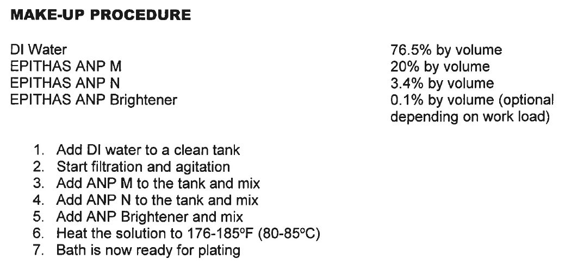
10.5 L NiP bath
→Take-out OLD 2.5L mixture, measure pH
→Add NEW 2.5L NiP mixture:
1,913 mL H2O
500 mL ANP-M
85 mL ANP-N
2.5 mL Brightener
→Filter, measure pH AND using 20% H2SO4, bring pH down to about 3.98
2.5 L NiP bath
for replenishment
after every 30++ wafer runs

